Slide 1
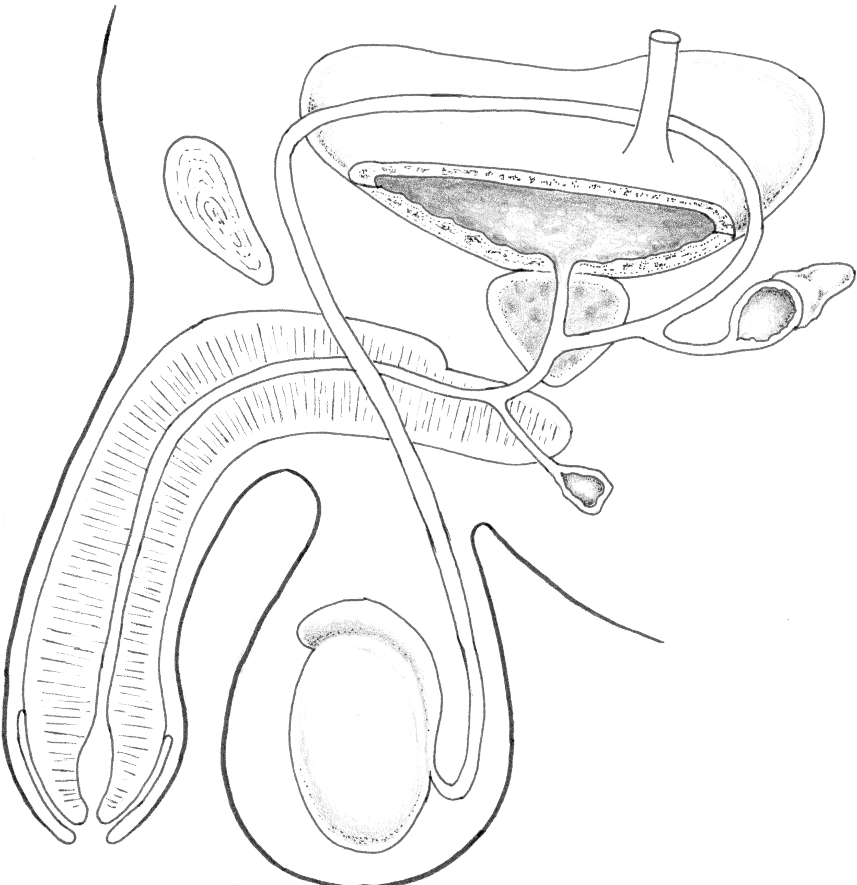
X
(i) Write down the names that should go in the blank boxes (3)
(ii) What is the function of the tube labelled X? (2)

Slide 2
The middle piece of a spermatozoa consists mainly of:
DNA
The flagella
Mitochondria
Cell membrane
The site of implantation in a human female is the:
Fallopian tube
Cervix
Uterine wall
Ovary
The hormone that initiates ovulation is
Progesterone
Testosterone
Follicle stimulating hormone
None of the above

Slide 3
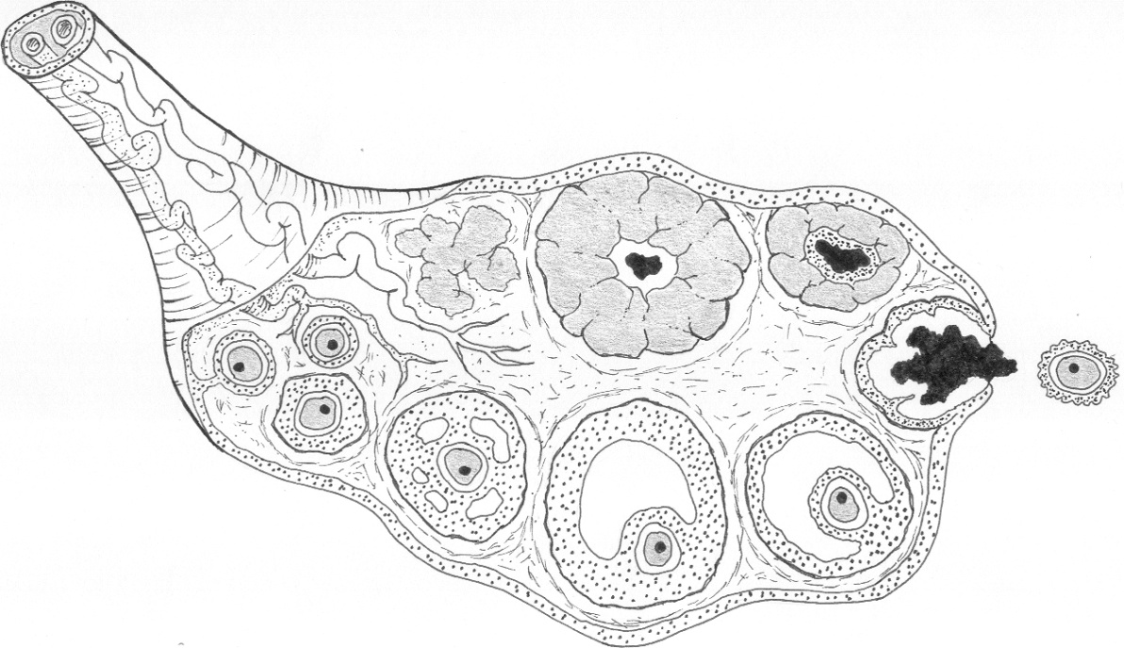
Z
Y
(i) Name the structure labelled Z and the main hormone that it secretes. (2)
(ii) What is the name of the structure labelled Y (cell layer around the ovum)? (1)
(iii) Explain how a sperm is able to penetrate Y. (2)

Slide 4
Which of the following statements about a ‘typical’ menstrual cycle is correct?
Ovulation occurs on Day 14
The onset of uterine bleeding is taken to be the first day of the cycle
Progesterone concentration in the blood is higher in the first half of the cycle
The endometrium is more vascular in the second half of the cycle
(v) The corpus luteum is at its largest between days 10 to 14
(i), (ii) & (iii) only
(i), (ii), & (iv) only
(iii), (iv) & (v) only
(i), (iii) & (iv) only.
Which of the following statements is not true?
The cortical reaction occurs to prevent a second sperm from entering the egg.
A blastocyst is a hollow ball of cells that embeds into the uterine wall using enzymes to digest and penetrate the lining.
The four-cell stage is most likely to occur when the developing embryo is in the uterus.
Skin and nerve tissue develop from the ectoderm (one of the three primary germ layers).

